Slide 1
MANAGEMENT CONCEPTS & PRACTICES
MODULE- I

Slide 2
Content of Module I
Introduction:
Concepts,
Nature, Objectives, Scope, and Significance.
Contribution of Taylor, Weber and Fayol in Management, Management Vs. administration
Planning:
Concept, objectives, nature, Importance, and limitations of Planning, Planning Process,
Decision Making:
Concept, importance, forms, Process and Techniques of Decision Making.
Organising:
Concept, objectives, nature, types, Delegation of Authority, Authority and Responsibility, Centralization and Decentralization, Span of Control

Slide 3
Management: As a Concept
It is an art of creating an environment in which people can perform and individuals and can co-operate towards attainment of group goals.
According to Harold Koontz, “Management is an art of getting things done through and with people in formally organized groups in a effective and efficient way.”
According to F.W. Taylor, “Management is an art of knowing what to do, when to do and see that it is done in the best and cheapest way”.

Slide 4
Nature of Management
Management is Goal-Oriented
Management Integrates Human, Physical and Financial Resources
Management is Continuous
Management is all Pervasive
Management is a Group Activity
Organized Activities
Management is Dynamic
Relative, Not Absolute Principles
Management is Universal

Slide 5
Whether Management is Science or Art

Slide 6
Management as a Science
Science is characterized by following main features:
Universally acceptance principles - Scientific principles represents basic truth about a particular field of enquiry. These principles may be applied in all situations, at all time & at all places. E.g. - law of gravitation which can be applied in all countries irrespective of the time.
Management also contains some fundamental principles which can be applied universally like the Principle of Unity of Command i.e. one man, one boss. This principle is applicable to all type of organization - business or non business.
Experimentation & Observation - Scientific principles are derived through scientific investigation & researching i.e. they are based on logic. E.g. the principle that earth goes round the sun has been scientifically proved.
Management principles are also based on scientific enquiry & observation and not only on the opinion of Henry Fayol. They have been developed through experiments & practical experiences of large no. of managers. E.g. it is observed that fair remuneration to personal helps in creating a satisfied work force.
Cause & Effect Relationship - Principles of science lay down cause and effect relationship between various variables. E.g. when metals are heated, they are expanded.
The same is true for management, therefore it also establishes cause and effect relationship. E.g. lack of parity (balance) between authority & responsibility will lead to ineffectiveness. If you know the cause i.e. lack of balance, the effect can be ascertained easily -in effectiveness.

Slide 7
Management as an Art
Art is characterized by following main features:
Personal skills: Every artist has his way of working. The use of basic knowledge varies from individual to individual. Even how they tackle their problems for reaching the result or the goal which they are willing to achieve differs. Applying this basic knowledge with practise, creativity, imagination, initiative, and innovation is a personal skill.
Creativity: Art consists of lots of creativity. The theoretical knowledge should be practised and applied differently to become more creative and achieve the ultimate goal.
Perfection through Practice: As arts require nonstop practice to gain mastery. By performing the task again and again, the artists gain perfection through practise. For example, a dancer who practices for hours daily will get smooth and perfect with his steps through practise.
The above arguments show that management have both the features of science as well as art. But it has more accurate features of art than science. So it can be said art as well as soft science.

Slide 8
Objectives or Significance of Management
Optimize resources
Increase efficiency
Maximize profits
Promote personal development
Uphold workplace morale
Reduce risk
Generate business strategies
Coordinate workflows

Slide 9
Scope of Management
Planning: This involves setting organizational goals, defining strategies to achieve them, and creating plans and budgets. It also includes forecasting, decision-making, and establishing objectives.
Organizing: This encompasses the design of the organizational structure, allocation of resources, delegation of authority, and establishing communication channels. Organizing ensures that tasks are efficiently and effectively carried out.
Leading: Leadership involves motivating and guiding employees, fostering teamwork, and resolving conflicts. Managers play a crucial role in inspiring and influencing their teams to achieve the organization's goals.

Slide 10
Scope of Management
Controlling: This involves monitoring the performance of the organization, comparing it to established standards, and taking corrective actions when necessary. Control mechanisms ensure that the organization stays on track and deviations are addressed.
Decision-Making: Managers are responsible for making important decisions related to the organization's operations, resources, and strategies. Decision-making is a critical aspect of management and impacts all other functions.
Human Resource Management: Managing people, including hiring, training, performance appraisal, and employee development, is a vital part of the scope of management.

Slide 11
Scope of Management
Financial Management: Ensuring the organization's financial health by budgeting, financial planning, cost control, and financial analysis is crucial for management.
Marketing Management: Developing and implementing marketing strategies to promote products and services, understand customer needs, and create value for the organization.
Operations Management: Overseeing the day-to-day operations and processes of the organization, optimizing efficiency and quality in production or service delivery.

Slide 12
Scope of Management
Strategic Management: Developing long-term strategies, setting the direction of the organization, and adapting to changing business environments.
Information Technology Management: Utilizing technology to enhance business processes, data management, and communication within the organization.
…………..Addressing ethical and environmental concerns, as well as being socially responsible in the organization's operations.

Slide 13
Theories of management
Classical Management includes
Scientific Management
Administration Management
Bureaucracy Management

Slide 14
I) Classical Management
A) Scientific Management
Frederick Winslow Taylor well-known as the founder of scientific management was the first to recognize and emphasis the need for adopting a scientific approach to the task of managing an enterprise.
Principles of scientific management:
Science, not rule of thumb
Harmony, not discord
Mental Revolution
Co-operation, not individualism
The development of each man to his greatest efficiency and prosperity

Slide 15
Principles of Scientific Management
Science, not the Rule of Thumb-
This rule focuses on increasing the efficiency of an organisation through scientific analysis of work and not with the ‘Rule of Thumb’ method. Taylor believed that even a small activity like loading paper sheets into boxcars can be planned scientifically. This will save time and also human energy.
Harmony, Not Discord-
Taylor indicated and believed that the relationship between the workers and management should be cordial and completely harmonious. Difference between the two will never be beneficial to either side. Management and workers should acknowledge and understand each other’s importance.
Mental Revolution-
This technique involves a shift of attitude of management and workers towards each other. Both should understand the value of each other and work with full participation and cooperation. The aim of both should be to improve and boost the profits of the organisation.

Slide 16
Principles of Scientific Management
Cooperation, not Individualism-
It is similar to ‘Harmony, not discord’ and believes in mutual collaboration between workers and the management. Managers and workers should have mutual cooperation and confidence and a sense of goodwill. The main purpose is to substitute internal competition with cooperation.
Development of Every Person to his Greatest Efficiency-
The effectiveness of a company also relies on the abilities and skills of its employees. Thus, implementing training, learning best practices and technology, is the scientific approach to brush up the employee skill.

Slide 17
b) Administrative Management
Henry Fayol is considered modern theory of general
the father of and industrial
management
The process of management as an ongoing
managerial organizing,
cycle involving planning, commanding,co-ordination, and
controlling, is actually based on the analysis of general management by Fayol.
– Hence, it is said that Fayol established the pattern of management thought and practice. Even today, management process has general recognition

Slide 18
Fayol's Principles of Management
Division of work: Division of work or specialization alone can give maximum productivity and efficiency.
Authority and Responsibility: The right to give order is called authority. The obligation to accomplish is called responsibility.
Discipline: The objectives, rules and regulations, the policies and procedures must be honoured by each member of the organization.
Unity of Command: In order to avoid any possible confusion and conflict, each member of an organization must receive orders and instructions only from one superior (boss).
Unity of Direction: All members of an organization must work together to accomplish common objectives.

Slide 19
Fayol's Principles of Management
Emphasis on Subordination of Personal Interest to General or Common Interest: This is also called principle of co-operation. Each shall work for all and all for each.
Remuneration: Fair pay with non-financial rewards can act as the best incentive or motivator for good performance.
Centralization: There must be a good balance between centralization and decentralization of authority and power.
Scalar Chain: The unity of command brings about a chain or hierarchy of command linking all members of the organization from the top to the bottom.
10. Order: Fayol suggested that there is a place for everything. Order or system alone can create a sound organization and efficient management.

Slide 20
Fayol's Principles of Management
Equity: An organization consists of a group of people involved in joint effort. Hence, equity (i.e., justice) must be there.
Stability of Tenure: A person needs time to adjust himself with the new work and demonstrate efficiency in due course.
Initiative: Creative thinking and capacity to take initiative can give us sound managerial planning and execution of predetermined plans.
Esprit de corps: Union is strength. It is the foundation of a sound organization. Pride, loyalty and sense of belonging are responsible for good performance.

Slide 21
C. Bureaucratic Management
Max Weber, a German scientist, defines bureaucracy as a highly structured, formalized, and also an impersonal organization.
He also instituted the belief that an organization must have a defined hierarchical structure and clear rules, regulations, and lines of authority which govern it.

Slide 22
Max Weber’s Bureaucratic Form – 6 Major Principles
A formal hierarchical structure – In a bureaucratic organization, each level controls the level below it. Also, the level above it controls it. A formal hierarchy is the basis of central planning and centralized decision-making.
Rules-based Management – The organization uses rules to exert control. Therefore, the lower levels seamlessly execute the decisions made at higher levels.
Functional Specialty organization – Specialists do the work. Also, the organization divides employees into units based on the type of work they do or the skills they possess.

Slide 23
Max Weber’s Bureaucratic Form – 6 Major Principles
Up-focused or In-focused Mission – If the mission of the organization is to serve the stockholders, board, or any other agency that empowered it, then it is up-focused. On the other hand, if the mission is to serve the organization itself and those within it (like generating profits, etc.), then it is in-focused.
Impersonal – Bureaucratic organizations treat all employees equally. They also treat all customers equally and do not allow individual differences to influence them.
Employment-based on Technical Qualifications – Selection as well as the promotion of employees is based on technical qualifications and skills.

Slide 24
Administration and Management
Administration:
The administration is a systematic process of administering the management of a business organization, an educational institution like school or college, government office or any nonprofit organization. The main function of administration is the formation of plans, policies, and procedures, setting up of goals and objectives, enforcing rules and regulations, etc.
Administration lays down the fundamental framework of an organization, within which the management of the organization functions.
Management:
Management is defined as an act of managing people and their work, for achieving a common goal by using the organization’s resources. It creates an environment under which the manager and his subordinates can work together for the attainment of group objective. It is a group of people who use their skills and talent in running the complete system of the organization.

Slide 25
Difference between Administration and Management
Basis | Administration | Management
Meaning
Focus | Management is primarily concerned with planning, organizing, directing, and controlling resources to achieve organizational goals. | Administration focuses on establishing policies, guidelines, and procedures to ensure the smooth operation of the organization.
Authority | Top level | Middle and Lower Level
Role | Decisive | Executive
Concerned with | Policy Formulation | Policy Implementation
Area of operation | It has full control over the activities of the organization. | It works under administration.
Applicable to | Government offices, military, clubs, business enterprises, hospitals, religious and educational organizations | Profit making organizations, i.e. business organizations.
Work | Formulation of plans, framing policies and setting objectives | Putting plans and policies into actions.
Represents | Owners, who get a return on the capital invested by them. | Employees, who work for remuneration

Slide 26
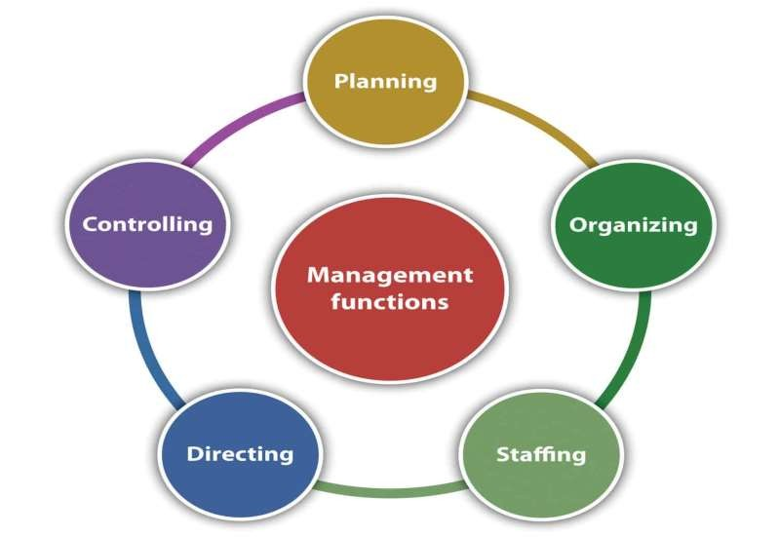
Management Functions

Slide 27
Planning
Planning is ascertaining prior to what to do and how to do. It is one of the primary managerial duties
According to Henry Fayol - "purveyance, which is an essential element of planning, covers not merely looking into the future but making provisions for it. A plan is then a projected course of action“
Before any operative action takes place it is necessary to decide what, where, when and who shall do the things.
According to Theo Haimann - "Planning is deciding in advance what is to be done. When a manager plans, he projects a course of action, for the future, attempting to achieve a consistent, co-ordinated structure of operations aimed at the desired results".

Slide 28
Nature of Planning
Planning is goal-oriented: Every plan must contribute in some positive way towards the accomplishment of group objectives. Planning has no meaning without being related to goals.
Primacy of Planning: Planning is the first of the managerial functions. It precedes all
other management functions.
Pervasiveness of Planning: Planning is found at all levels of management. Top management looks after strategic planning. Middle management is in charge of administrative planning. Lower management has to concentrate on operational planning.
Limiting Factors: A planner must recognise the limiting factors (money, manpower
etc) and formulate plans in the light of these critical factors.
5. Flexibility: The process of planning should be adaptable to changing environmental
conditions.
6. Planning is an intellectual process: The quality of planning will vary according to the
quality of the mind of the manager.

Slide 29
Importance of Planning
As a managerial function planning is important due to the following reasons:-
To manage by objectives: All the activities of an organisation are designed to achieve certain specified objectives. However, planning makes the objectives more concrete by focusing attention on them.
To offset uncertainty and change: Future is always full of uncertainties and changes. Planning foresees the future and makes the necessary provisions for it.
To secure economy in operation: Planning involves, the selection of most profitable course of action that would lead to the best result at the minimum costs.
To help in co-ordination: Co-ordination is, indeed, the essence of management, the planning is the base of it. Without planning it is not possible to co-ordinate the different activities of an organisation.
To make control effective: The controlling function of management relates to the comparison of the planned performance with the actual performance. In the absence of plans, a management will have no standards for controlling other's performance.
To increase organisational effectiveness: Mere efficiency in the organisation is not important; it should also lead to productivity and effectiveness. Planning enables the manager to measure the organisational effectiveness in the context of the stated objectives and take further actions in this direction.

Slide 30
Importance of Planning
As a managerial function planning is important due to the following reasons:-
7. Efficiency, Economy and Accuracy: Efficiency of plan is measured by its contribution to the objectives as economically as possible. Planning also focuses on accurate forecasts.

Slide 31
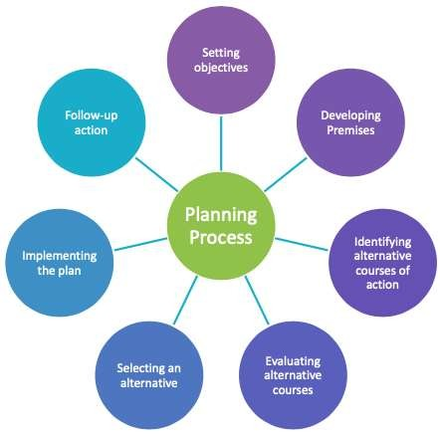
Planning Process

Slide 32
Planning Process
Setting Objectives: The idea behind planning is to achieve desired objectives. Therefore, the first step is to clearly define and describe the objectives of the organization. Firstly, the major objectives should be specified, and then they should be broken down into individual, sectional and departmental objectives.
Developing Planning Premises: The next step in planning is to establish premises. Planning premises are the anticipated environment in which the plans are expected to operate. These include assumptions and forecasts in the future and knowing conditions that will affect the course of the plan. In short, these provide the environment and the boundaries within which the plans will be executed.

Slide 33
Planning Process
Identifying alternative courses of action: After setting the objectives and making assumptions about the future. The next step is to determine alternative courses of action through which the organization can achieve its objectives. To increase sales, the company may has many alternatives like decreasing prices, increasing advertisement, promotion, and after-sale service.
Evaluating alternative courses: After identifying different alternatives the next step is to evaluate each alternative. Evaluation means the study of the performance of various actions. All the possible alternatives should be evaluated keeping in mind their expected cost and benefit to the organization. Comparison among the alternatives should be made in terms of factors, such as the risk involved, planning premises, goals to be achieved, etc.

Slide 34
Planning Process
Selecting an alternative: After evaluating various alternatives, the next step is to select the most suitable force of action. The basic, detailed, and derivative plans, such as policies, rules, programs, and budgets should be formulated.
Implementing the plan: This step is concerned with transforming the plan into action. The plan must be communicated to the employees in detail. This, in turn, will help to secure cooperation from them. Useful suggestions from employees must be considered, and they should be motivated to execute the plan to the fullest of their abilities.

Slide 35
Planning Process
Selecting an alternative: After evaluating various alternatives, the next step is to select the most suitable force of action. The basic, detailed, and derivative plans, such as policies, rules, programs, and budgets should be formulated.
Implementing the plan: This step is concerned with transforming the plan into action. The plan must be communicated to the employees in detail. This, in turn, will help to secure cooperation from them.
Follow-up- action: After implementing the plan, the last step is to periodically review the existing plan to ensure that the plan is effective. The plan must be consistently monitored, and in case of any deficiency, it should be modified and adjusted.

Slide 36
Limitations/Disadvantages of Planning
Planning Leads to Rigidity
The plans are rigid in nature and have to be complied with throughout the organisation. Such rigidity of plans may be internal as well as external. Internal rigidity relates to plans, policies, programs, rules, and methods, etc. External rigidity relates to political, industrial, technological, legal and economic changes, etc.
Example: A super speciality hospital has fine branches in a city. Whatever the top management of the hospital decides the head of the branch of the hospital and their subordinates have to follow. Though on occasions they know they could have done better on their own but the plan laid out provides rigidity to their approach.
2. Planning May Not Work in Dynamic Environment
The environment in which a business survives is dynamic as it keeps on changing. It is difficult for an organisation to access future trends, the taste of customers, natural calamity, competitors’ policies and effects of changes in the different components of the environment. The dynamic environment may sometimes lead to failure of plans.
Example: Nestle, a very successful producer was very proactive in deciding strategies for Maggi noodles. Maggi noodles were in a lot of demand but they were off the shelf due to political and legal dimensions. This was due to the high content of lead in Maggi noodles.

Slide 37
Limitations/Disadvantages of Planning
3. Planning Reduces Creativity
Planning is mostly done by the top management and other members like middle and lower levels of management have to follow these plans. They can’t deviate or change the plans made by their seniors.
Under such circumstances, employees become orders following machines and don’t involve creative thinking from their side.
Example: The need for a branch of a renowned shoe manufacturing company sees a lot of scope in customized shoes. The top management is not interested in this idea as the company manufactures standardised shoes.
4. Planning Involves Huge Cost
Formulation of plans can be too much costly because there is a lot of time and money is involved. Some costs are incidental in nature like- expenses on boardroom meetings, discussions with professional experts and preliminary investigations to find out the feasibility of the plan.
Example: Companies like IBM spend a lot of money on research. Many world-class levels give their advice to this company and change their fee. However, without so much of painstaking such a huge company won’t be able to sustain itself. So planning in case of IBM becomes necessary.

Slide 38
Limitations/Disadvantages of Planning
5. Planning is a Time-consuming Process
Planning is a very lengthy process as it consumes a lot of time for collection, analysis, and interpretation of data.
Due to such a lengthy process, sometimes decisions get delayed, opportunities are lost and there is not much time left for the implementation of plans.
Example: Health Is Wealth Ltd. plans to organise 25 health checkup camps on the World Health Day and send a requisition to the top management but management could send its approval just a day before and the sales manager could organise only 5 camps and thus huge opportunity is lost. Here the implementation was delayed.
6. Planning Does Not Guarantee Success
The success of an enterprise is possible only when plans are properly drawn up and implemented. Plans become meaningless if it is not translated into action.
Managers have a tendency to rely on previously tried and tested successful plans.
Example: In a paint manufacturing company, the top management very meticulously chalked out a great plan. The whole company worked out on the plan in a much focused manner. However, with the entrance of a competitor with better paint quality the whole plan failed. The reason for the failure was the dynamic conditions which were not in control of the organisation.

Slide 39
Decision-Making
The word decision has been derived from the Latin word "decidere" which means "cutting off". Thus, decision involves cutting off of alternatives between those that are desirable and those that are not desirable. Decision is a kind of choice of a desirable alternative.
In the words of George R. Terry, "Decision- making is the selection based on some criteria from two or more possible alternatives".

Slide 40
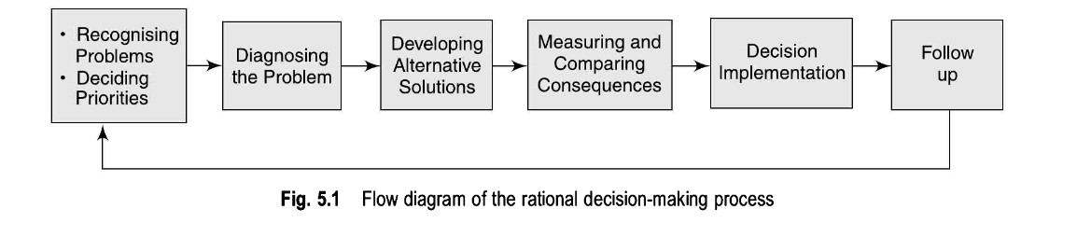
Decision-making Process

Slide 41
Decision-making Process
Recognising Problems:
First of all it is necessary to search the environment for the existence of the problem. A problem exists:
When there is a deviation from past experience
When there is a deviation from the plan
When other people bring problems to the managers
When competitors outperforms the organization
Deciding Priorities among Problems
A manager should not allow himself/herself allow to be bogged down by all sorts of problems. Some problems which can be solved by subordinates can be transferred to them, some may need to be referred upward because they affect other departments or need higher information. Some problems may be deferred because it may not be the best time to act.

Slide 42
Decision-making Process
Diagnosing the Problem:
Identifying problems is important . .and challenging. In the real world, most problems don’t come with neon signs identifying them as such. And problem identification is subjective. A manager who mistakenly solves the wrong problem perfectly is just as likely to perform poorly as the manager who fails to identify the right problem and does nothing.
Developing Alternative Solution or Course of Action
Generally, for every problem there are alternative solutions. For instance, if a factory manager is considering to raise the production to meet increased demand, he can (i) build a new plant, or (ii) buy better equipment, or (iii) add extra shift, or (iv) authorise overtime.

Slide 43
Decision-making Process
Measuring and Comparing the Consequences of Alternative Solution
The next step in decision-making is to measure and compare the consequences of alternative solution. This involves a comparison of the quality and acceptability of various solutions. The quality of a solution must be determined after taken into account its tangible and intangible outcomes.
Decision Implementation
A decision is not complete until it is not translated into action. This requires the communication of the decision to the employees in clear and unambiguous terms. Failure to inform who needs to know of the decision can lead to unfortunate results.

Slide 44
Decision-making Process
Follow-up of Action
In the final step, the action should be continuously followed up, to ensure whether the decision is achieving is desired purpose and whether the forecasts and assumptions upon which the decision was based are still valid.
Changing conditions necessitate new decisions and the new process begins again.

Slide 45
Decision-making Techniques
SWOT Analysis
Decision Matrix
Brainstorming

Slide 46
SWOT Analysis
A SWOT analysis is a strategic planning tool used by businesses to identify and evaluate their Strengths, Weaknesses, Opportunities, and Threats. It helps organizations understand their internal capabilities and external environment, allowing them to develop strategies to capitalize on strengths, mitigate weaknesses, exploit opportunities, and defend against threats. Here's a breakdown of each component:
Strengths:
Internal attributes and resources that give the organization an advantage over competitors.
Examples may include strong brand reputation, innovative products, loyal customer base, efficient processes, or talented workforce.
Weaknesses:
Internal factors that hinder the organization's performance and competitiveness.
These could be areas where the organization lacks resources, skills, or capabilities compared to competitors.
Examples might include outdated technology, poor management practices, limited financial resources, or low employee morale.

Slide 47
SWOT Analysis
Opportunities:
External factors in the environment that the organization could exploit to its advantage.
These could include emerging markets, changes in consumer preferences, technological advancements, or gaps in the competitive landscape.
Identifying opportunities allows the organization to pursue growth and expansion strategies.
Threats:
External factors that could negatively impact the organization's performance and viability.
These might include intense competition, economic downturns, regulatory changes, technological disruptions, or shifts in consumer behavior.
Recognizing threats helps the organization anticipate challenges and develop contingency plans.

Slide 48
Decision Matrix
A decision matrix is a helpful tool for comparing multiple options based on different criteria. To create a decision matrix for three products, you first need to identify the criteria you want to evaluate them on. Let's say we have three products: Product A, Product B, and Product C. Here's an example of how you could set up a decision matrix:
Criteria: Price, Quality, Features
Now, let's create a matrix where we'll compare each product against these criteria on a scale of 1 to 5, with 5 being the highest:
Criteria | Product A | Product B | Product C
Price | 3 | 4 | 2
Quality | 4 | 5 | 3
Features | 3 | 4 | 5
In this example, we're using a scale from 1 to 5, where: 1 means very poor, 2 means poor, 3 means average, 4 means good, 5 means excellent.
After filling out the matrix with ratings for each product, you can then calculate totals for each product by adding up the scores across each row. This will give you a numerical representation of how each product performs across all criteria, helping you make a more informed decision.

Slide 49
Brainstorming
Brainstorming is a group creativity technique that is often used to find a solution to a specific problem. This is accomplished by gathering and recording new ideas from team members in a free-flowing manner.
Brainstorming sessions are usually made up of a handful of core team members, and typically are led by a director or facilitator.
Quantity of ideas is usually emphasized over quality, with the goal of generating as many new suggestions as possible. Once all ideas have been collected, the team then evaluates each of them and focuses on the ones that are most likely to solve the problem.
The four principles of brainstorming
Quantity over quality
Withhold criticism
Welcome the crazy ideas
Combine, refine, and improve ideas

Slide 50
Organizing
Once a plan has been created, a manager can begin to organize. Organizing involves assigning tasks, grouping tasks into departments, delegating authority, and allocating resources across the organization.
According to Louis A. Allen, "Organisation is the process of identifying and grouping the work to be performed, defining and delegating responsibility and authority, and establishing relationships for the purpose of enabling people to work most effectively together in accomplishing objectives."

Slide 51
Objectives of Organizing
The objectives of organizing within an organization include:
Clarifying Responsibilities:
Organizing helps to define roles and responsibilities within the organization, ensuring that each individual understands what they are accountable for and how their work contributes to overall objectives.
Optimizing Resource Utilization:
Organizing aims to allocate resources, including human, financial, and physical resources, in the most efficient and effective manner possible to maximize productivity and minimize waste.
Facilitating Communication:
By establishing clear lines of communication and reporting structures, organizing helps to facilitate the flow of information within the organization, ensuring that relevant information reaches the right people at the right time.

Slide 52
Objectives of Organizing
Promoting Specialization:
Organizing allows for the specialization of tasks and the division of labor, enabling individuals to focus on areas where they have expertise or experience, which can lead to increased efficiency and productivity.
Encouraging Coordination:
Organizing aims to coordinate the activities of different individuals, departments, or units within the organization to ensure that they work together towards common goals and objectives.
Fostering Adaptability:
Effective organizing structures are flexible and adaptable, allowing the organization to respond quickly to changes in the external environment or internal dynamics.

Slide 53
Process of Organizing
Determination of objectives
Enumeration of activities
Grouping activities
Allocation of fixed responsibilities
Delegation of authority
Coordination

Slide 54
Authority, Responsibility, Accountability
Authority
Authority is all about rights or powers with the managers which the organization empowers them for achieving a common organizational goal. Thus, it involves the power of assigning duties to workers and asking them to accept and pursue the assigned work
Responsibility
According to McFarland, Responsibility is the duties or responsibilities allocated to a position or executive. Responsibility is the obligation that comes with a job. It simply means the person needs to commit to the job and complete it.
Accountability
McFarland defines Accountability as, "the obligation of a person to register formally to their senior executives about the task to discharge the Responsibility." Accountability definition in management goes, "It is all about the liability created to handover the Authority". Accountability makes an individual answerable about the task or job he/she has done.

Slide 55
Difference between Authority, Responsibility and Accountability
Basis | Authority | Responsibility | Accountability
Meaning | It means the right to take decision and command subordinates. | It means the obligation to perform the assigned task. | It means being answerable for the final outcome.
Origin | It originates from job position in the scalar chain. | It arises from delegated authority. | It arises from responsibility.
Flow | It flows downward from superior to subordinate. | It flows upward i.e. from subordinate to superior. | It flows upward i.e. from subordinate to superior.
Delegation | It can be delegated. | It can’t be delegated entirely. | It can’t be delegated at all.
Nature | Authority is a power. | Responsibility is an obligation. | Accountability is answerability.

Slide 56


CENTRALIZATION AND DECENTRALIZATION
16

Slide 57
CENTRALIZATION
According to Allen, “Centralization” is the systematic and consistent reservation of authority at central points in the organization”
The implication of centralization can be :-
Reservation of decision making power at top level.
Reservation of operating authority with the middle level managers.
Reservation of operation at lower level at the directions of the top level.

Slide 58
Importance of Centralization
Clear Chain of Command
Focused Vision
Reduced Costs
Quick Implementation
Improved Quality of Work

Slide 59
Limitations of Centralization
Autocratic leadership
Remote control
Delays in work
Lack of employee loyalty
Loss of employee creativity

Slide 60
DECENTRALIZATION
According to Allen “Decentralization refers to the systematic effort to delegate to the lowest level of authority except that which can be controlled and exercised at central points”
“Everything that increasing the role of subordinates is decentralization and that decreases their role is centralization.”

Slide 61
Importance of Decentralization
Develops initiative among subordinates:
Develops managerial talent for the future
Quick decision making:
Relief to top management:
Facilitates growth:
Better Control:

Slide 62
Limitations of Decentralization
Lack of Uniformity:
Costly and Uneconomical:
Limitation of Scale:
Conflict:

Slide 63
Span of Control
In management, the span of control refers to the number of subordinates or direct reports that a manager or supervisor can effectively oversee and manage. It's essentially the number of individuals for whom a manager is responsible.

Slide 64
Span of Control
Narrow Span of Control: In this case, a manager oversees a smaller number of subordinates. This can allow for more hands-on supervision, closer monitoring, and more personalized attention to each employee.
Wide Span of Control: Here, a manager oversees a larger number of subordinates. This structure promotes decentralization, faster decision-making, and can foster a more flexible and adaptive organization.

Slide 65
Factors Affecting Span of Control
Ability of the Manager
Ability of the Employees
Type of Work
Well-defined authority and responsibility
Geographic Location
Level of Management

Slide 66
Departmentation/Organizational Structure
Departmentation or organizational structure refers to the process of grouping related activities or functions into specialized units or departments within an organization.

Slide 67
Functional Departmentation/Structure
In this structure, Departments are organized based on functions or tasks performed. For example, departments may include marketing, finance, human resources, operations, and so on.

Slide 68
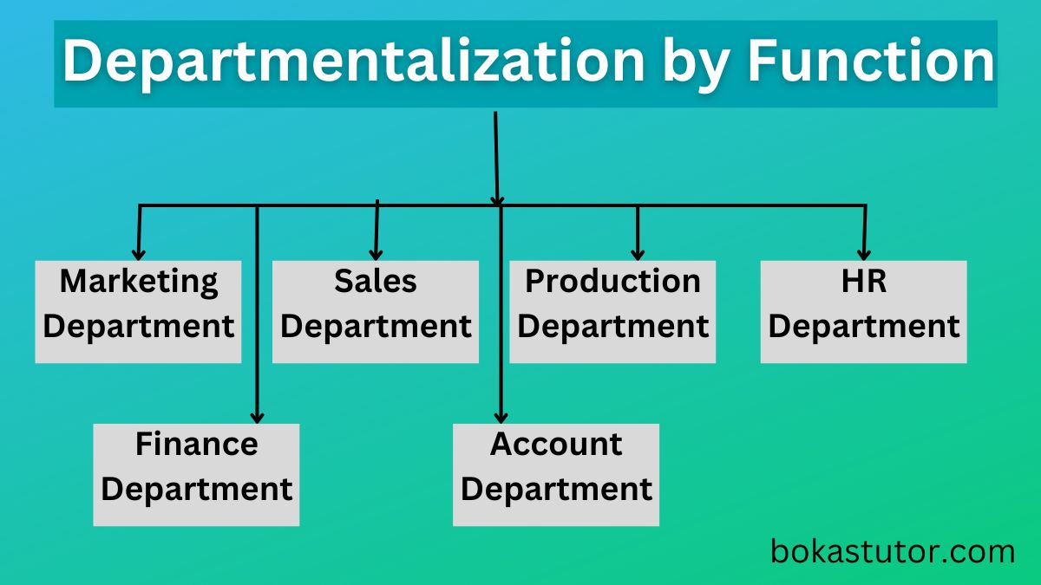

Slide 69
Benefits of Functional Departmentation/Structure
Specialization: Functional departmentation allows employees to focus on specific tasks or functions within their area of expertise, leading to higher levels of proficiency and productivity.
Efficiency: By grouping together individuals with similar skills and knowledge, functional departments can streamline processes and workflows, reducing duplication of efforts and increasing overall efficiency.
Clear Reporting Structure: Functional departmentation typically involves a clear hierarchy, with each department reporting to a designated manager or head. This clarity in reporting lines can facilitate decision-making and accountability.
Career Development: Employees in functional departments often have opportunities for career advancement within their specialized area, as they can gain deeper expertise and experience over time.
Cost Savings: By consolidating similar activities and resources, functional departmentation can lead to cost savings through economies of scale and more effective resource allocation.

Slide 70
Limitations of Functional Departmentation/Structure
Communication Barriers: Functional departmentation may result in silos, where departments operate independently and communication between them becomes challenging. This can hinder collaboration and coordination across the organization.
Lack of Holistic View: Employees within functional departments may focus solely on their own area of responsibility, potentially overlooking the broader organizational goals and objectives. This can lead to suboptimal decision-making and a lack of alignment with overall strategic direction.
Conflict and Tension: Different functional departments may have competing priorities or conflicting interests, leading to internal tensions or conflicts. This can impede cooperation and teamwork within the organization.
Difficulty in Innovation: Functional departmentation may discourage cross-functional collaboration, limiting opportunities for innovation and creativity that often arise from diverse perspectives and interdisciplinary approaches.
Overall, while functional departmentation offers certain advantages such as specialization and efficiency, organizations need to be mindful of its limitations and consider adopting hybrid approaches or implementing mechanisms to mitigate potential drawbacks.

Slide 71
Product Departmentation/Structure
Departments are organized around different products or product lines. This type of departmentation allows for a focus on specific products or services, which can lead to better coordination and expertise in those areas.

Slide 72
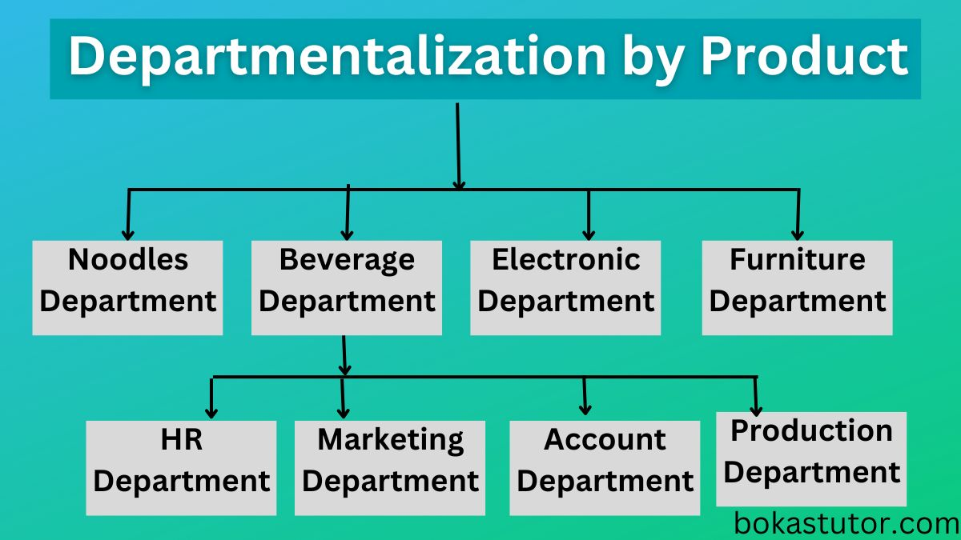

Slide 73
Benefits of Product Departmentation/Structure
Specialization: Each product department can focus solely on its specific product or product line, allowing for specialized knowledge and expertise. This can lead to improved product development, marketing, and customer support.
Clear Accountability: With distinct product departments, accountability becomes clearer. Each department is responsible for its own product's success or failure, which can improve decision-making and efficiency.
Flexibility: Product departmentation allows for flexibility in responding to market changes and customer demands. Each department can adapt its strategies independently, making it easier to customize approaches based on product-specific requirements.
Customer Focus: Since each product department is dedicated to a particular product or product line, there's a greater potential to understand and address customer needs and preferences effectively.
Innovation: Product departments often foster innovation within their specific product domain. They can allocate resources, conduct research, and develop new features or products tailored to their market segment.

Slide 74
Limitations of Product Departmentation/Structure
Duplication of Effort: Each product department may require its own set of resources, including personnel, equipment, and facilities. This can lead to duplication of effort and increased costs across departments.
Coordination Challenges: Coordinating activities and sharing resources across product departments can be challenging. There may be conflicts over resource allocation, and communication between departments may suffer, potentially leading to inefficiencies and missed opportunities.
Narrow Perspective: Product departmentation may result in a narrow focus on individual products or product lines, potentially overlooking synergies or opportunities for collaboration across different products or markets.
Difficulty in Scaling: As the company grows or diversifies its product offerings, managing multiple product departments can become increasingly complex. It may be difficult to scale the organizational structure efficiently while maintaining cohesion and coordination.
The effectiveness of product departmentation depends on factors such as the company's size, industry, and strategic objectives, and careful consideration is needed to balance its benefits and limitations.

